Slide 1
The Computing Curriculum
Simon Humphreys
Computing At School
6th March 2014
simon.humphreys@computingatschool.org.uk,
@CompAtSch

Slide 2
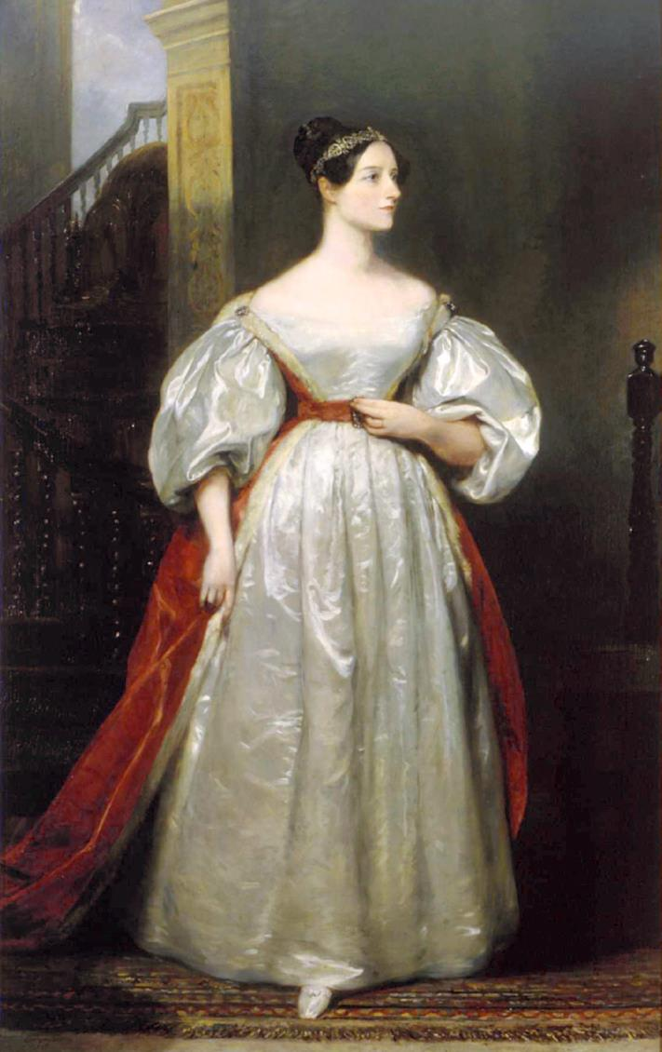
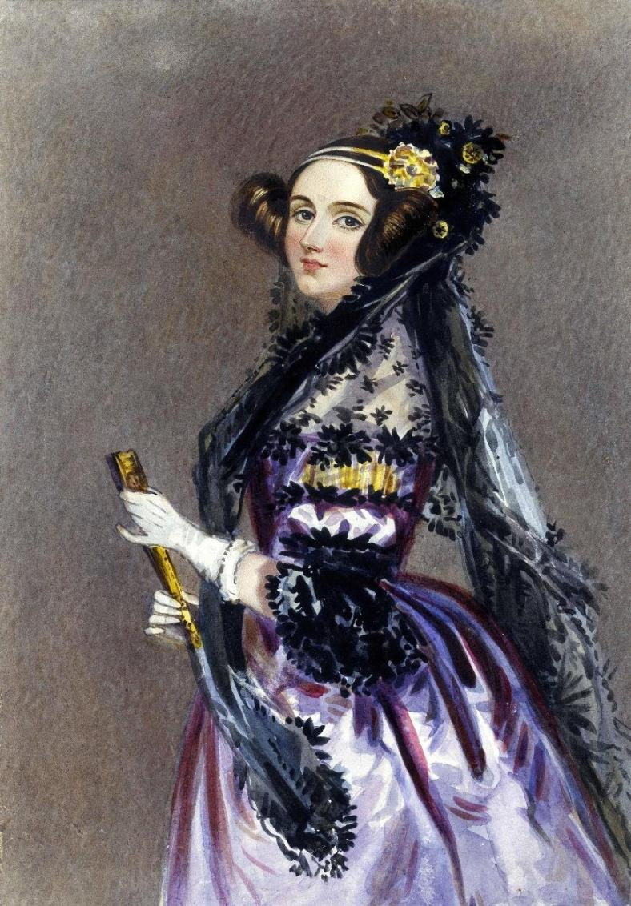
1843
Notes:
We have an august heritage in this country for the history of computing. I know that were I brought up in America, or Germany I may have a different slant on such history but we have some extraordinary stories to tell about our role in this revolution.
Augusta Ada Byron born Augusta Ada Byron in 1815 saw the potential in Charles’ Babbage’s Analytical engine of 1843. Her notes on the engine are recognised as the first algorithm intended to be processed by a machine.

Slide 3
1943
Notes:
Colossus @ BletchleyPark. Designed by Tommy Flowers to help decipher encrypted teleprinter messages. It is the first programmable digital computer. Dot and Elsie shown here operating it in 1943. It was some years before the notion of a computer as a general purpose machine would come to prominence …

Slide 4
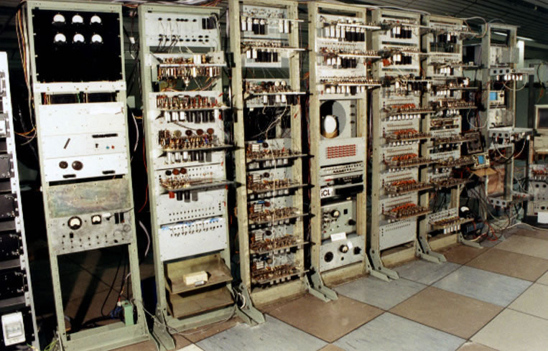
1948
Notes:
.. And this was created here in Manchester – of course! The first stored program computer using a whopping 128 bytes of memory

Slide 5
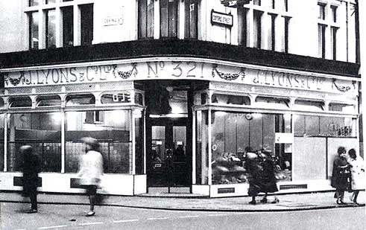
1951
Notes:
Lyons built their own computers to help with the distribution of cakes and other perishable goods. They also handled their accounts and payroll.
But I do not need to expand on this any more I think. We have an extraordinary legacy, some extraordinary pioneers and a history in computer science of which we can be justly proud.

Slide 6
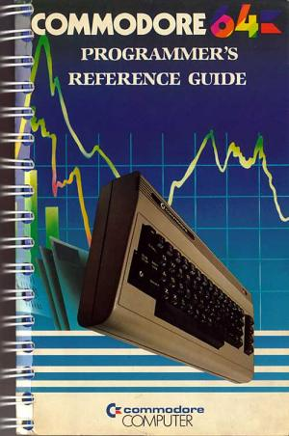
1982
Notes:
The revolution in personal computing is our more recent phenomenon. I am, of course, far too young to remember this! This advert from the 80s Observer (“Saturday’s Child”) talks about expectations and challenge. The sinclair range and the BBC micro simply too off! At the time Britain had the highest number of computers her head in the world. Note, and this is the important point isn’t it that when these computers were sold they came with DETAILED programming and user guides. It was a natural consequence that Computer studies would become popular in school, and the exams were tough!

Slide 7
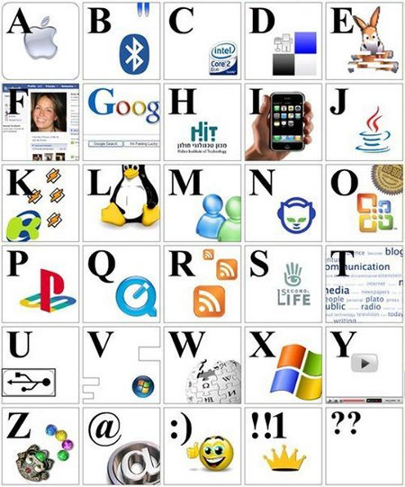
http://www.geekologie.com/2009/11/early-computing-childrens-new.php

Slide 8
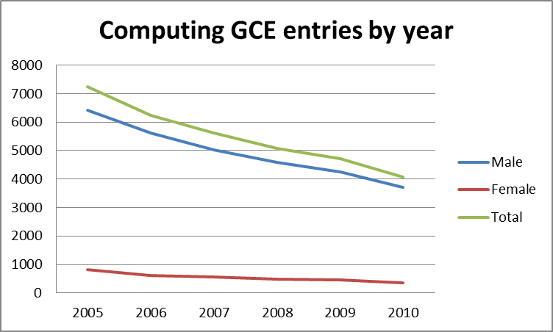
The context

Slide 9
The context
 | ICT | Computer Science | Maths
2002 | N/A | 28,000 | -
2003 | 16,000 | 8,000 | 56,000
… | … | … | …
2012 | 11,000 | 4,000 | 85,000

Slide 10
“In my vision, the child progams the computer and, in so doing both acquires a sense of mastery over a piece of the most modern and powerful technology and establishes an intimate contact with some of the deepest ideas from science, from mathematics, and from the art of intellectual model building”
Seymour Papert, 1980

Slide 11
Computing At School (2008 …)
Computer Science should be recognised in school as a rigorous subject discipline, like physics or history, quite distinct from the (useful) skills of digital literacy.

Slide 12
Next Gen
Recommendation 1
Bring computer science into the National Curriculum as an essential discipline

Slide 13
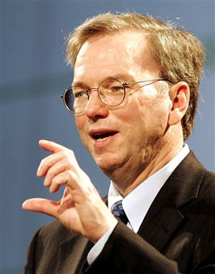
Eric Schmidt
"I was flabbergasted to learn that today computer science isn't even taught as standard in UK schools," he said. "Your IT curriculum focuses on teaching how to use software, but gives no insight into how it's made."
Eric Schmidt – Edinburgh 2011

Slide 14
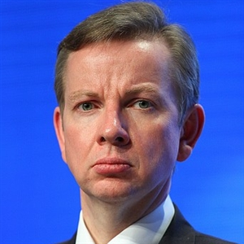
Michael Gove
“Computer Science is a rigorous, fascinating and intellectually challenging subject … we will certainly consider including Computer Science as an option in the English Baccalaureate …
Although individual technologies change … they are underpinned by foundational concepts and principles that have endured for decades … the principles learnt in Computer Science will still hold true.”
Michael Gove, January 2012

Slide 15
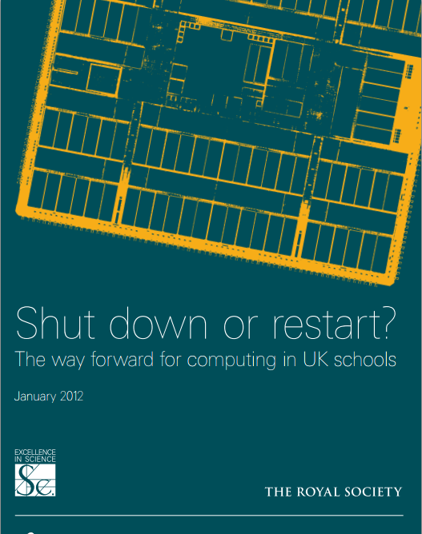
Shutdown or Restart?
Recommendation 6
The DfE should remedy the current situation, where good schools are dis-incentivised from teaching Computer Science, by reforming and rebranding the current ICT curriculum in England, Schemes of work should be established for ages 5-14 across the range of Computing aspects, e.g. digital literacy, Information Technology, and Computer Science

Slide 16
What is Computer Science?
Computer Science is the study of the foundational principles and practices of computation and computational thinking, and their application in the design and development of computer systems.
A model curriculum for Computer Science has been developed by CAS.

Slide 17
Computer Science is a discipline
At school, we teach both disciplines and technologies & skills
Disciplines
Principles, ideas
Knowledge, laws
Techniques, methods
Broadly applicable
Dates slowly
Technologies & skills
Artefacts
Machines
Programs
Products
Organisations
Business processes
Dates quickly
Physics, chemistry, mathematics, English
Budgeting, presentation skills, metalwork, textiles

Slide 18
What is “Computer Science”?
What students should know: languages, algorithms, data structures and representation, architecture, programs, communication and coordination.
What students should be able to do: computational thinking, abstraction, modelling, design, problem solving, programming.

Slide 19
What is “Computer Science”?
Foundational
Not just “coding” (although that too)
Not just to get a good job (although that too)
The “fourth science”
Ubiquitous, like maths: biology, ecology, design, engineering, astronomy, medicine,…
Primarily rooted in ideas rather than technology
But a quintessentially STEM subject

Slide 20
Main new thrust of the PoS
Just as every student needs to learn a bit of chemistry, even though few will become chemists, so every student should learn a bit of computer science (including some elementary programming) because they live in a digital world. “...understanding how the modern world works...” (Matthew Hancock)
From primary school onwards (like science).

Slide 21
Result
New title clearly signals a qualitative change
Computer Science added as the “fourth science” to the EBacc

Slide 22
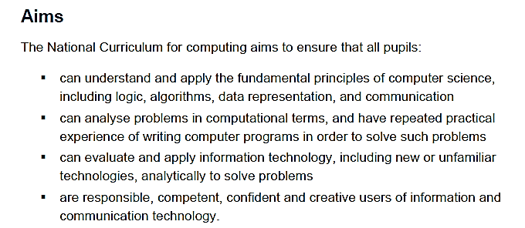
Aims of the PoS

Slide 23
“What” not “how”
Very strong steers from DfE: “What” not “how”; hence lack of words like “creativity”
“National curriculum should be dry and boring” (Tim Oates)
POS should specify
Principles
Concepts
Methods
Techniques
…but should not specify
Project based learning
Project management skills
Group working
Pedagogy
Creativity
How to make the subject inspiring

Slide 24
Ambition
Computer science from KS1 is ambitious; eg “understand what algorithms are”.
High degree of confidence that students can understand this stuff
We cannot get there instantly; but the PoS has to last for a decade
“PoS is a minimum” (David Brown Ofsted)
Need for
Teacher support and training across KS1-4
Transitional Ofsted assessment

Slide 25
The once in a generation opportunity
A consensus that change is needed

Slide 26
The once in a generation opportunity
A consensus that change is needed
Review of the National Curriculum

Slide 27
The once in a generation opportunity
A consensus that change is needed
Review of the National Curriculum
Deep community engagement

Slide 28
What is CAS doing?
Influencing national policy
Computing: a curriculum for schools
Directly support teachers
“on the ground”

Slide 29
Teachers: the myth
ICT teachers are not very good
They are happy with the status quo
They couldn’t teach computer science even if we wanted them to
So: we are stuck at Square 1

Slide 30
Teachers: the reality
Most teachers live and die for their students: they work nights
Few are happy with the status quo
It’s the biggest sales environment ever. Always going for figures, always going for gold, always going for 100%. ICT is purely there to boost the results in my school, that’s all it’s there for.
I’m afraid I’ve done enough dragging students through qualifications, it’s demoralising and it’s morally wrong, so I’m moving on
Half the year group choose ICT because they enjoyed it so much at KS3, but then KS4 just squeezes the creativity out, it sucks the life out of the subject and they hate it
The exam is just so easy compared to the silly amount of effort they have to put into doing the coursework in order to get basic grades… my kids do no work for the exams and do really well at them

Slide 31
Teachers: the reality
Many teachers are longing to introduce computing, but they feel
isolated (seldom more than one ICT specialist in a school)
under-qualified (even specialist ICT teachers seldom have a computer science degree)
under the gun for results (a Computing GCSE will be demanding)
But they are keen. Very keen. Very very keen.

Slide 32
Background to CAS
BCS are the collaborative partner with CAS
10,000 members (approx. 70% teachers)
97 Regional hubs
Active online community
Newsletter, events, conferences
Network of Excellence
Key stakeholder in development of curriculum
Building grassroots communities of practice

Slide 33
Community of Practice
“A community of practice is a group of people who share a common concern, a set of problems, or interest in a topic and who come together to fulfil both individual and group goals. CoPs often focus on sharing best practices and creating new knowledge to
advance a domain of professional practice. Interaction on an ongoing basis is an important part of this.”
Connect people
Provide a shared context
Enable dialogue
Stimulate learning
Capture and diffuse existing knowledge
Introduce collaborative processes
Help people organize
Generate new knowledge
http://net.educause.edu/ir/library/pdf/nli0531.pdf

Slide 34
Model of teacher professional development in the UK
Hubs &
Online forums
Workshops/
Training
courses
Network of Excellence
Model (from university to school to school)
Community of Practice
Cascade
Training
Accreditation
Action Research
Modeling good practice
CAS Master Teacher/
Digital Schoolhouse model
Notes:
CAS is building a variety of activities that directly support teachers

Slide 35
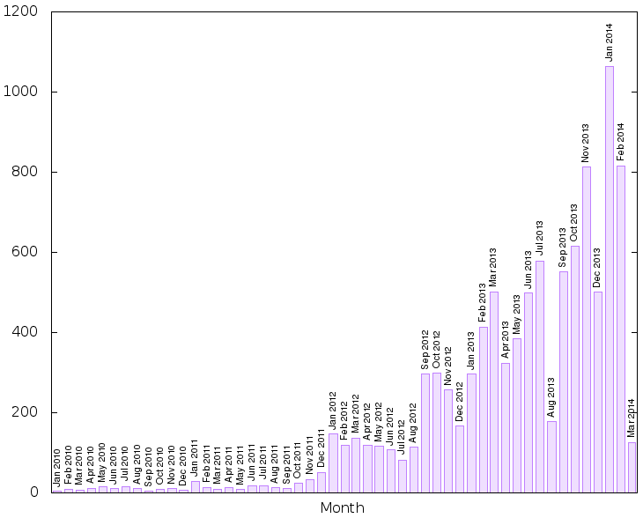

Slide 36
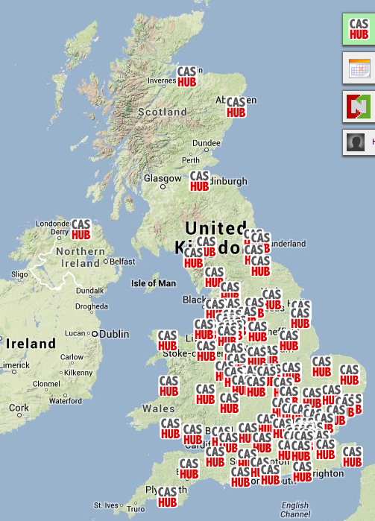
Regional Hubs
A CAS hub is a meeting of teachers and lecturers who wish to share their ideas for developing the teaching of computing in their schools, their classrooms and their community. It is a meeting of like-minded professionals with the general objective of supporting each other and the specific aim of providing (at least) one idea that can be taken and tried in the classroom.

Slide 37
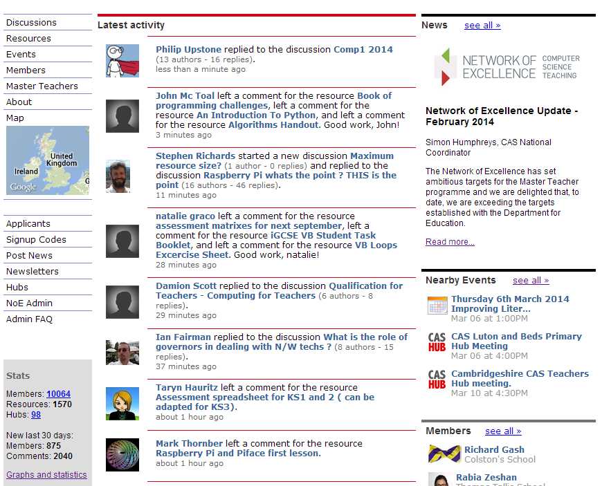

Slide 38
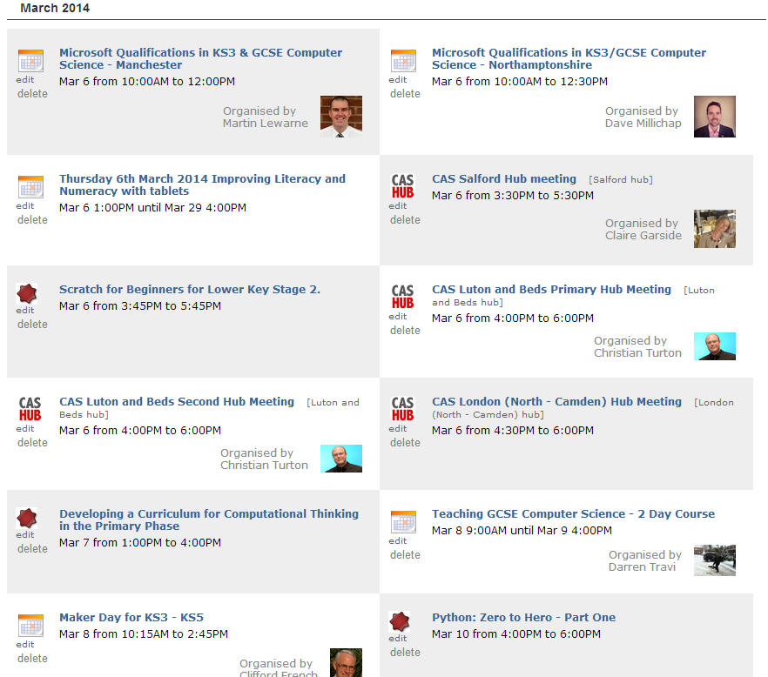

Slide 39
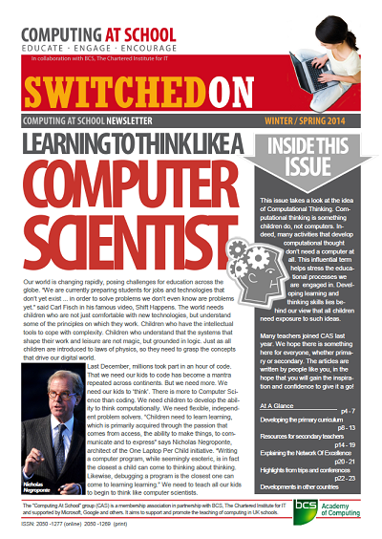
Newsletter

Slide 40
Notes:
CAS, with BCS, have launched the Network of Excellence to provide a start to the issue of CPD for teachers. It’s a drop in an enormous ocean but we have to start somewhere. Bill will provide more detail but …

Slide 43
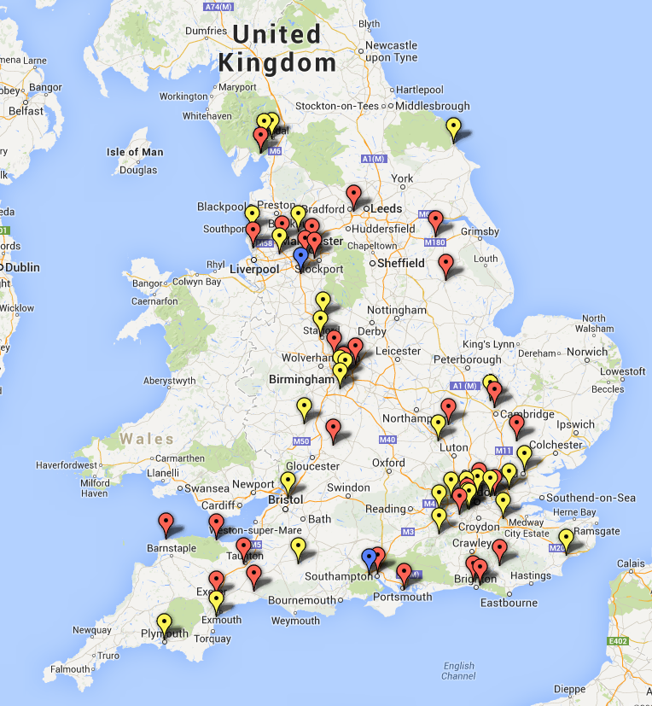
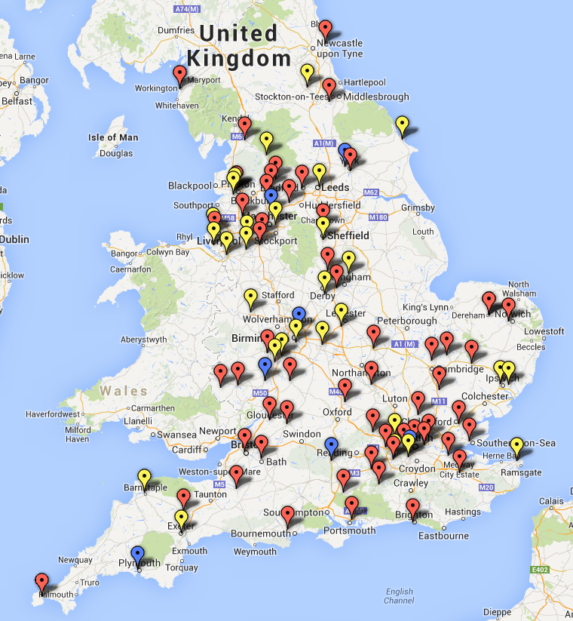
Network of Excellence
Primary Master Teachers
Secondary Master Teachers

Slide 44
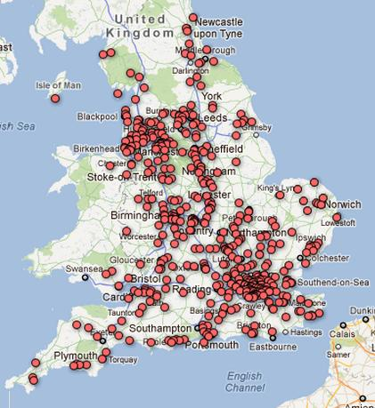
Schools

Slide 45
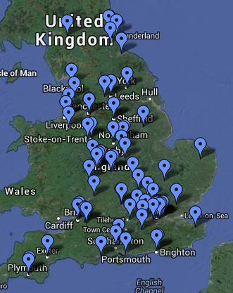
Network of Excellence
University faculty are central to the success of the Network.
Need for both subject knowledge and pedagogical knowledge development.
Encourage university colleagues to forge links with the primary and secondary schools
Work with master teachers in the area design and deliver courses
Training of Level 1 Master Teachers

Slide 46
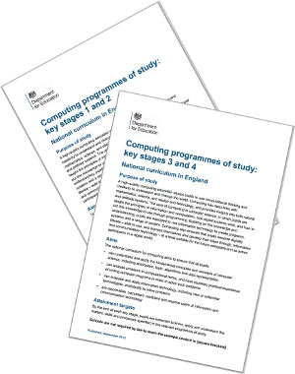
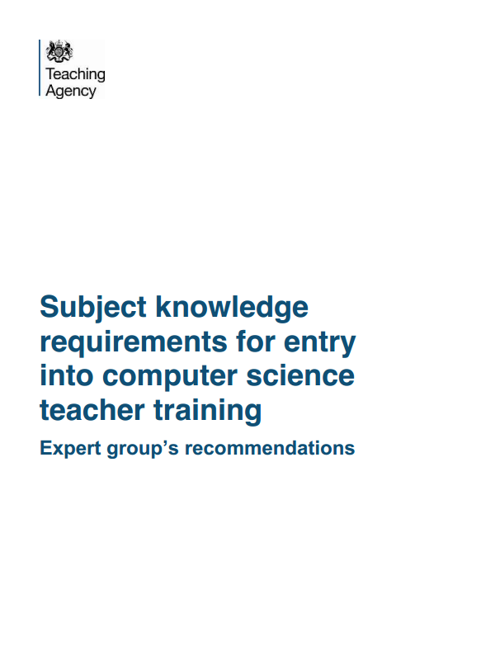
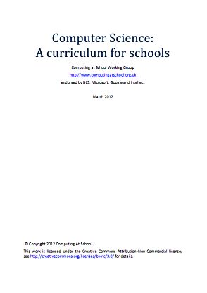
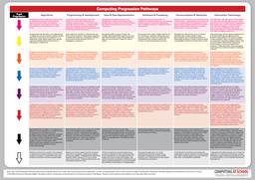
Content

Slide 47
Certification
Pilot (54 teachers)
Evidence based
A commitment to improving/maintaining subject knowledge and skills in Computer Science
Computer Science knowledge and skills, including programming skills
Understanding of and application of pedagogical strategies suitable for teaching Computer Science
Three components
CPD, inc reflection and impact
CS subject knowledge via project
Practioner research, classroom based

Slide 48
Challenge #1
Introduce a new subject discipline, computer science, to the UK education system, starting from a near-zero base

Slide 49
Challenge #2
Equip, support, affirm, encourage our ICT teachers to teach computer science

Slide 50
ACTIONS
Join CAS!
Go to your local CAS hub
Become a Code Club volunteer
Help mentor a teacher
Become a cs4fn speaker
Open a dialogue with your children's school Head of Computing, Head Teacher, or governors
Offer to help with an after-school club
Help interview would-be Computing teachers
Offer to host visits from school classes
Arrange, with support from CAS and colleagues, a "Hack Day".

Slide 51
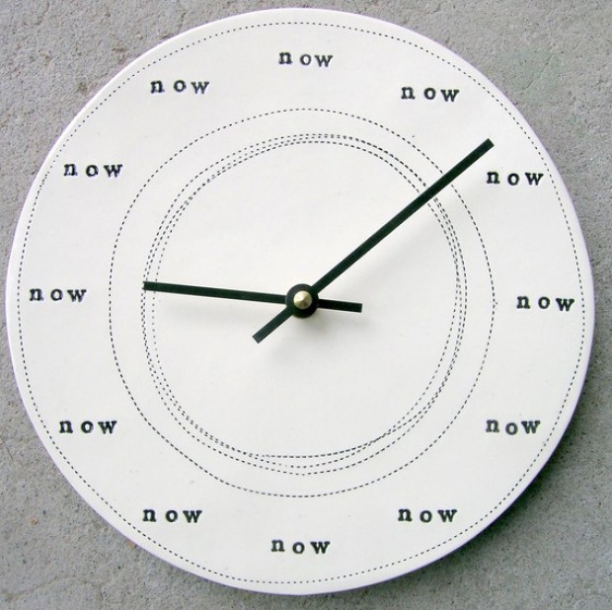
http://churchm.ag/the-time-is-now/

Slide 52
Any Questions
Simon Humphreys
Computing At School
6th March 2014
simon.humphreys@computingatschool.org.uk,
@CompAtSch

